Slide 1
Drone Project
Shiwei Chen

Slide 2
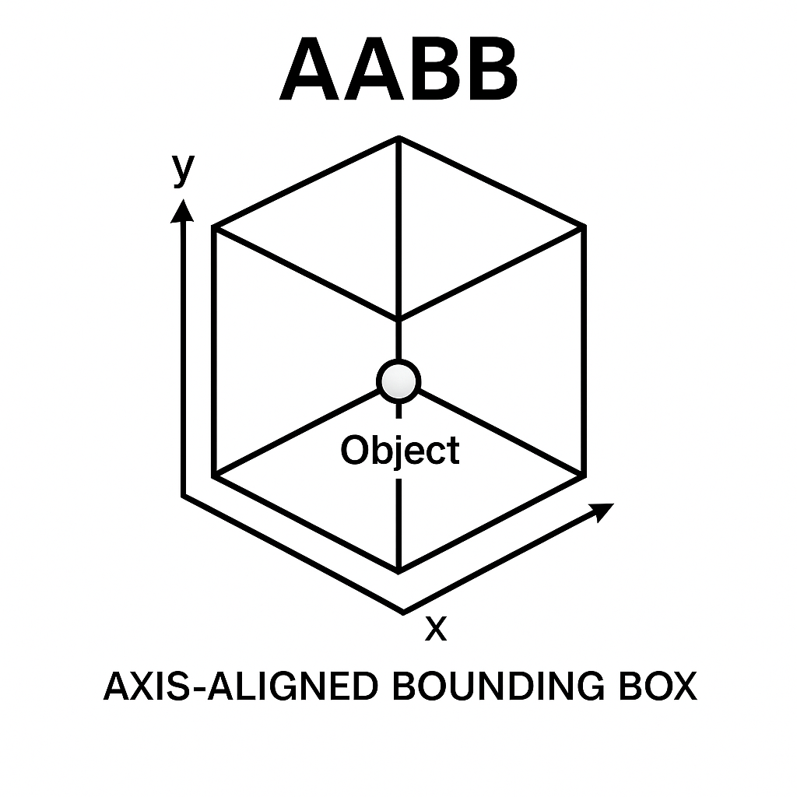
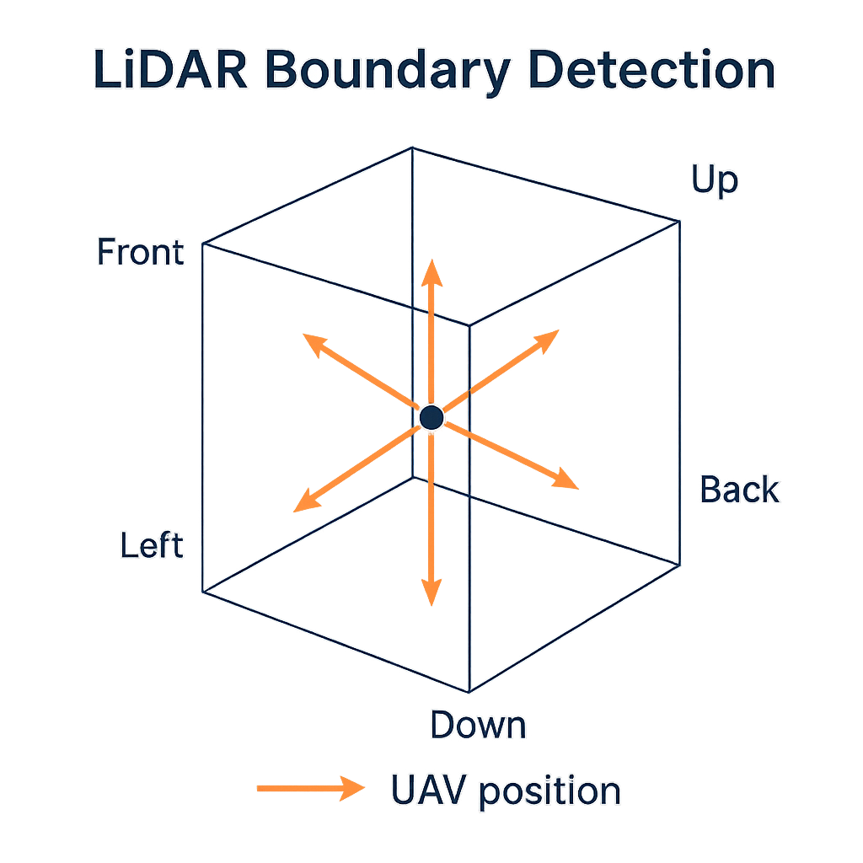
LIDAR implementation principle
AABB_Box
Left
Method
Slab_Mothod
Front
Back
Right

Slide 3
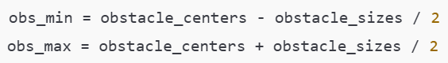
Axis-Aligned Bounding Box
This diagram illustrates how LiDAR rays intersect Axis-Aligned Bounding Boxes (AABBs)
Each obstacle is represented as a box defined by its center and size
The code calculates the min and max corners of each box and uses ray-box intersection logic
positions: drone positions (E, 3)
directions: LiDAR ray directions (E, 6, 3)
Yaw:The angle(E,)
obstacle_centers: center position (E, obs_num, 3)
obstacle_sizes: size of each obstacle (E, obs_num, 3)
max_range: maximum LiDAR detection range

Slide 4
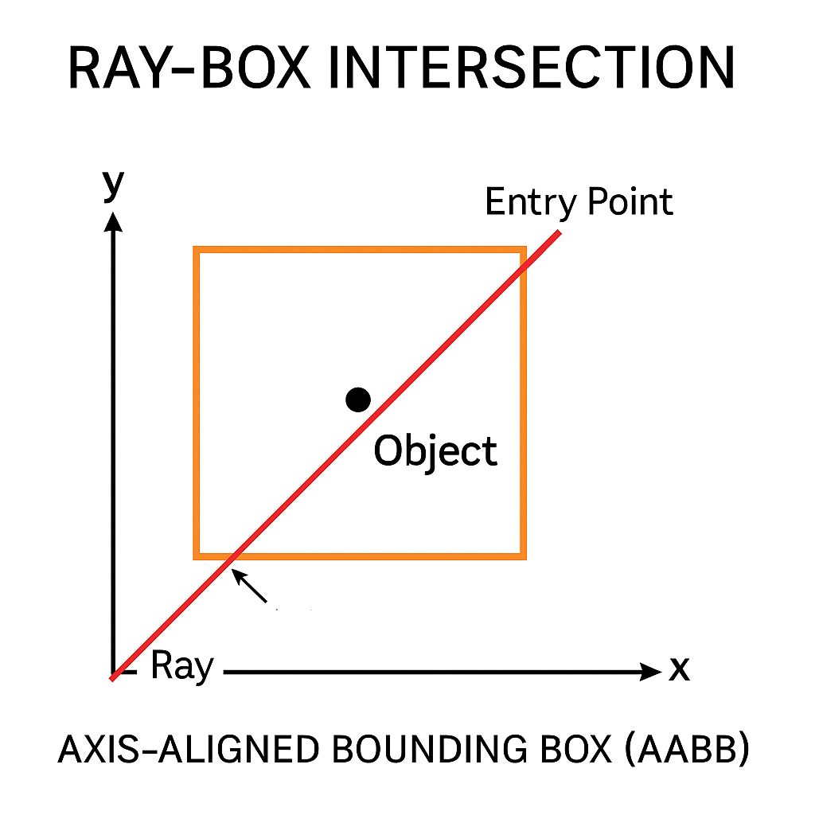
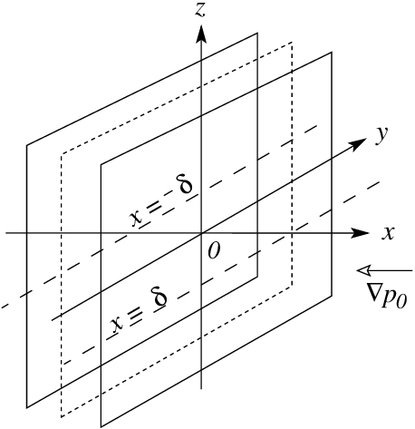
How LIDAR detects the obstacle
T_Far
T_Close
The red ray checks whether it hits the box
X=-δ is the exact place T=T_close
X=+δ is the exact place T=T_Far

Slide 5
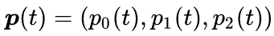
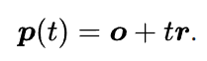
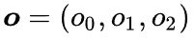
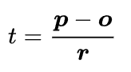
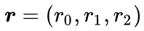
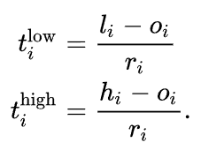
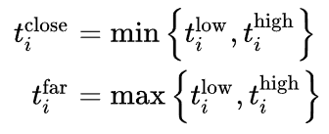
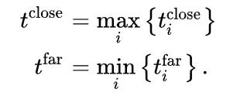
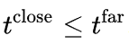
SLAB method in 3 Directions
Hit point:
Drone Position:
Computaional Formula
Lidar_Vector:
Like Low_x
Like High_x
Doing such computation in 3 directions
Must all the rays are in the box(Lastest)
Only need is one to go out(Earliest）
We only care the front Laser
And of course the t_close ≥0 and t_far ≥0 is mandatory

Slide 6
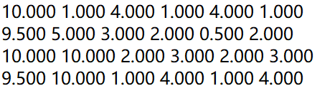
The Output of the Lidar
Drone Multi-Deck Sensor
Drone_Position(X,Y,Z)
Dimension=(E,3)
Min_Distance
Dimension=(E,6)
Lidar_Vector
Dimension=(E,6,3)
The Drone_Position_Set
Drone Postion
[ 1, 1, 1]
[ 5, 2, 2]
[10, 3, 3]
[15, 4, 4]
The result Matrix
X+ X- Y+ Y- Z+ Z-
Env0
Env1
Env2
Env3

Slide 7
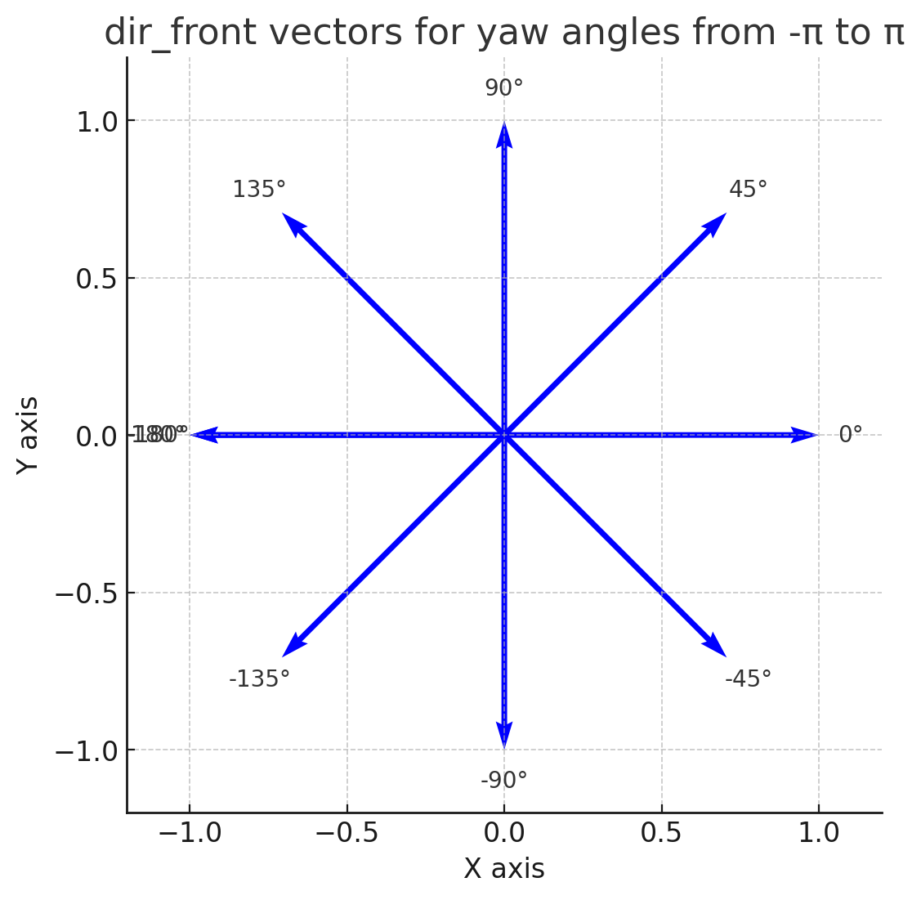
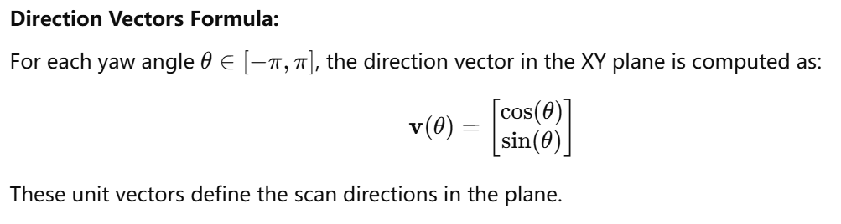
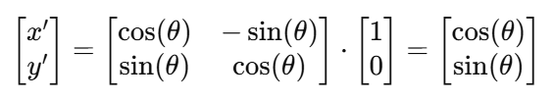
LIDAR characteristics
Max_Detect_Range = 10M
Lidar with automatic rotation in the XY plane
X_Force
Action Dimension = (E,4)
Y_Force
Z_Force
Yaw

Slide 8
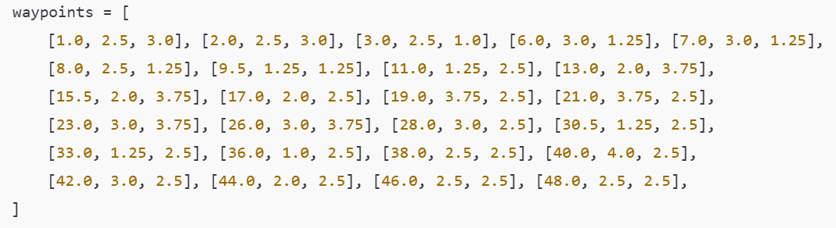
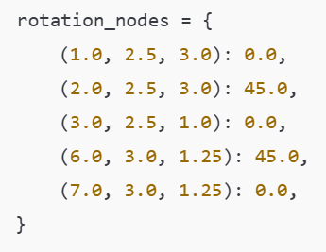
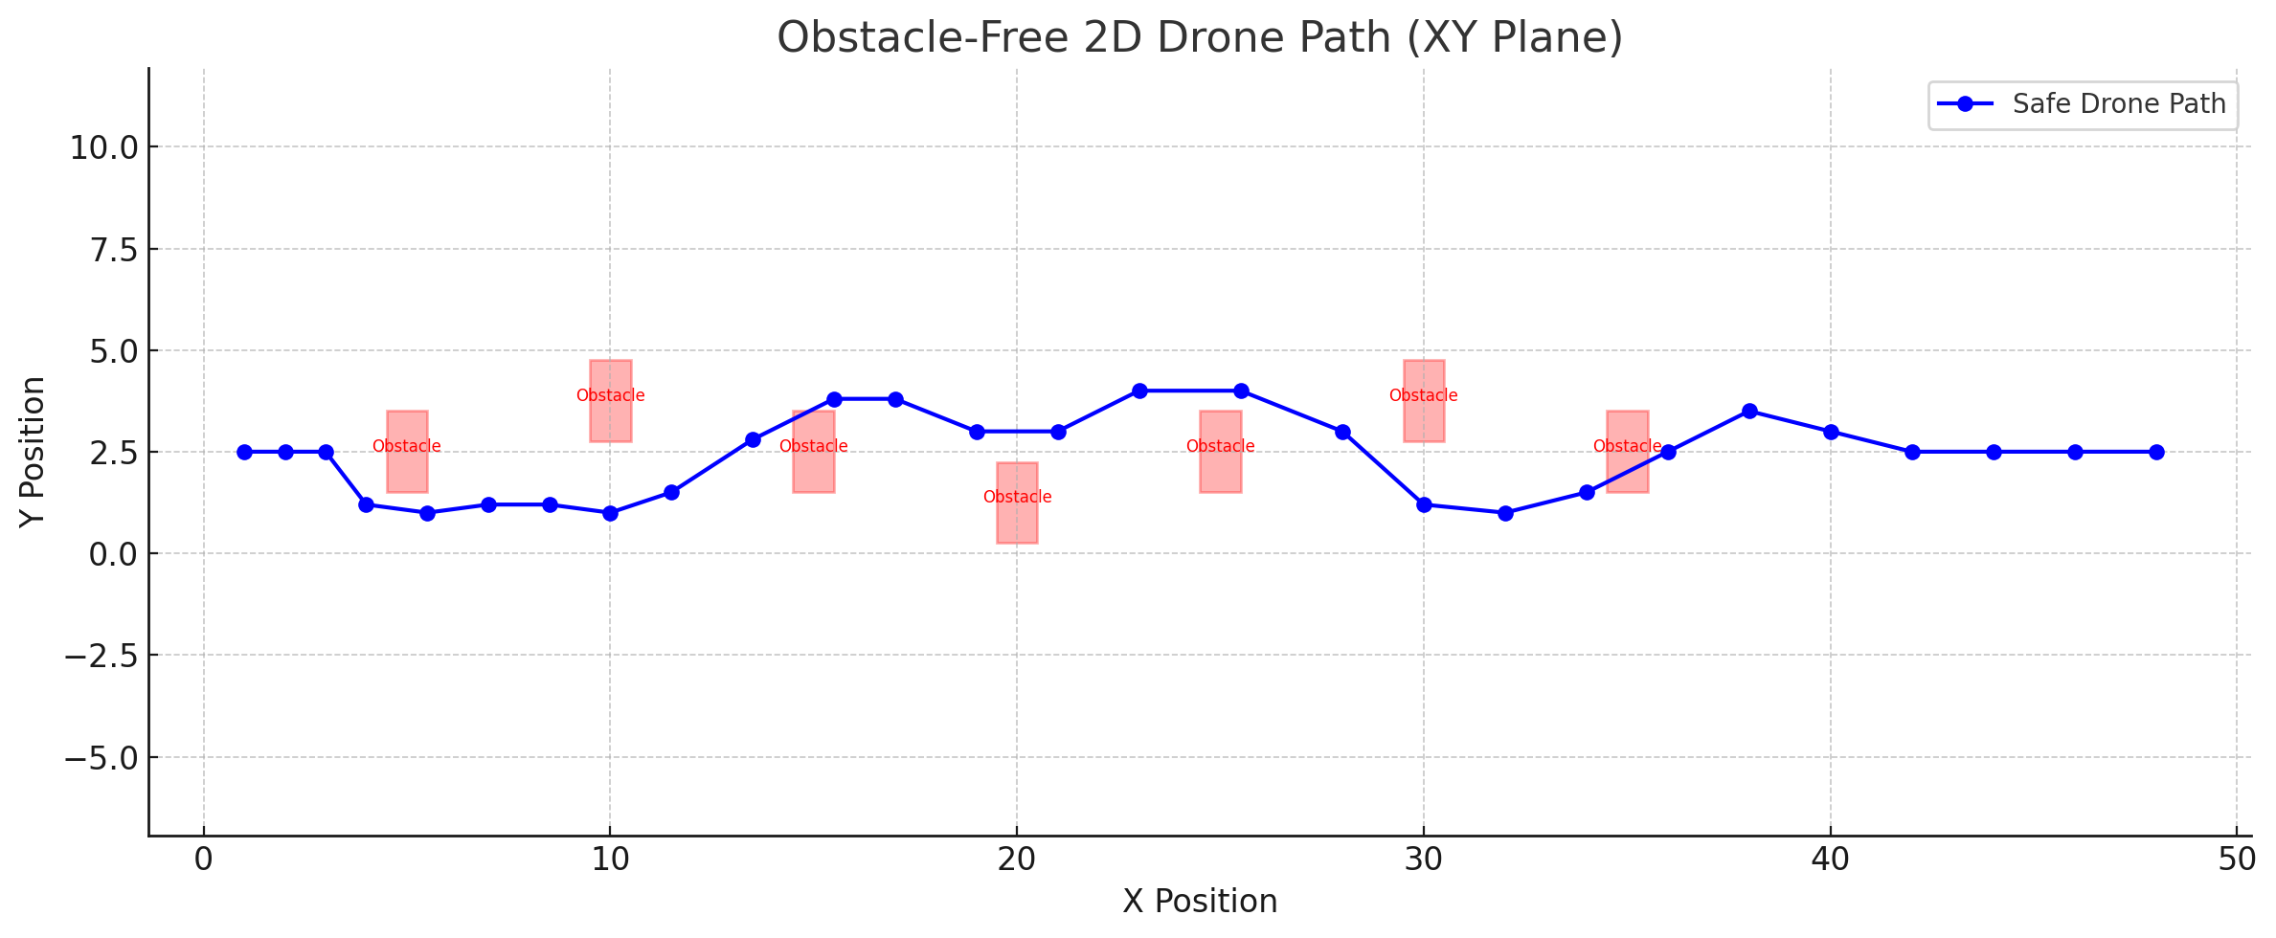
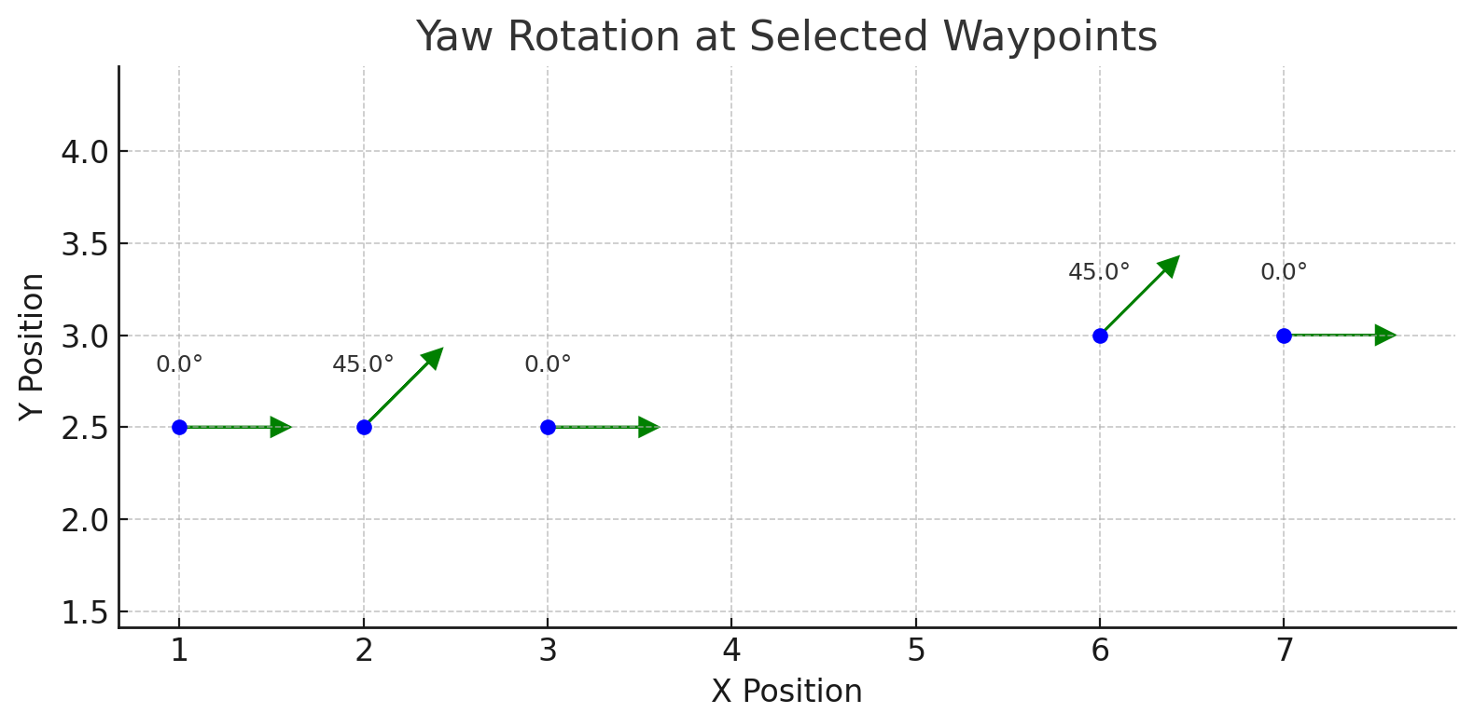
Lidar_Test
In order to individually test if the LIDAR's range and steering functions are working correctly, I wrote a file to test it, and here are the coordinate path points
Each test point records two sets of data: one before rotation and one after rotation
The waypoints are carefully designed to avoid all obstacles

Slide 9
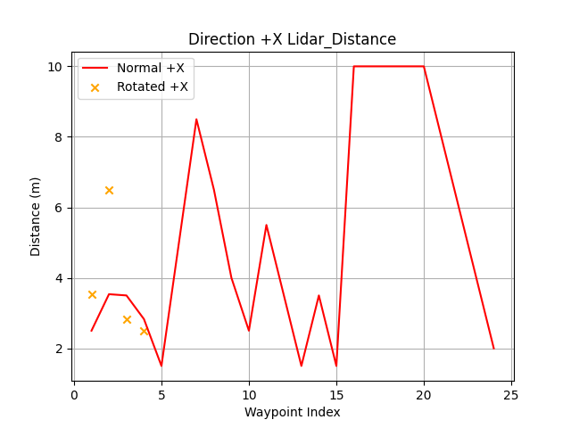
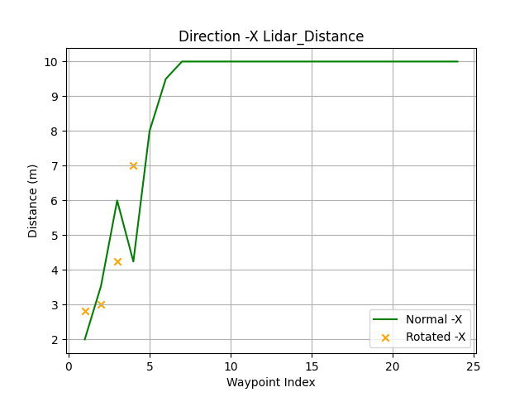
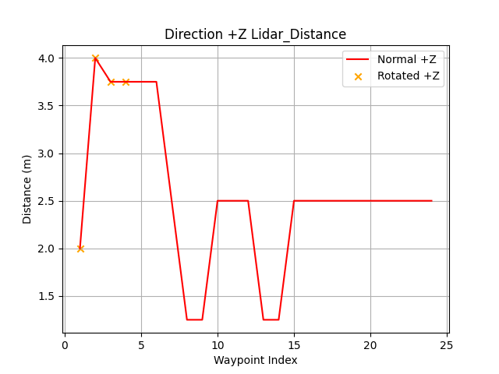
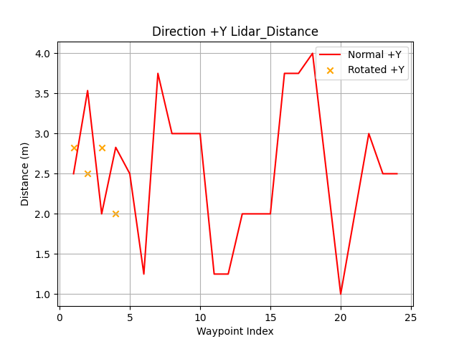
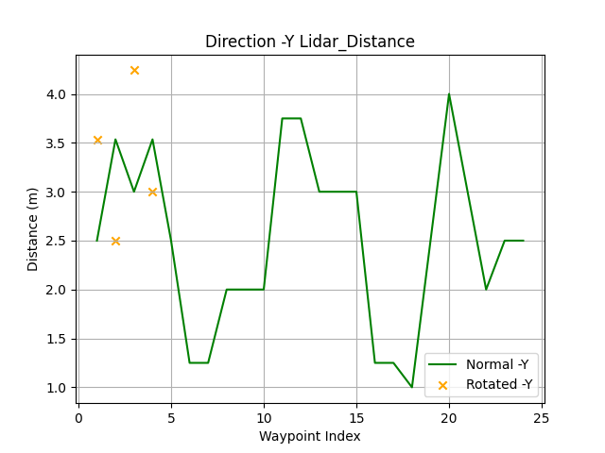
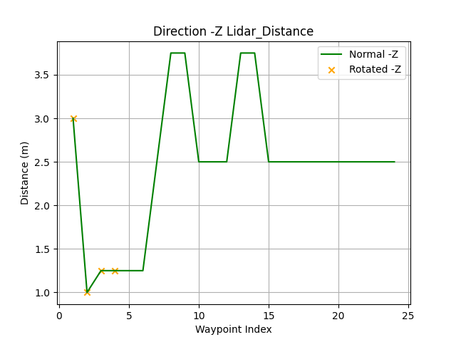
Plot of the test results

Slide 10
Test Results of the lidar
NORMAL - Waypoint 1 | Pos [2.0, 2.5, 3.0] | Lidar: [+X:2.50, -X:2.00, +Y:2.50, -Y:2.50, +Z:2.00, -Z:3.00]
ROTATE_BEFORE - Waypoint 1 | Pos [2.0, 2.5, 3.0] | Lidar: [+X:2.50, -X:2.00, +Y:2.50, -Y:2.50, +Z:2.00, -Z:3.00]
ROTATE_AFTER - Waypoint 1 | Pos [2.0, 2.5, 3.0] | Lidar: [+X:3.54, -X:2.83, +Y:2.83, -Y:3.54, +Z:2.00, -Z:3.00]
NORMAL - Waypoint 2 | Pos [3.0, 2.5, 1.0] | Lidar: [+X:3.54, -X:3.54, +Y:3.54, -Y:3.54, +Z:4.00, -Z:1.00]
ROTATE_BEFORE - Waypoint 2 | Pos [3.0, 2.5, 1.0] | Lidar: [+X:3.54, -X:3.54, +Y:3.54, -Y:3.54, +Z:4.00, -Z:1.00]
ROTATE_AFTER - Waypoint 2 | Pos [3.0, 2.5, 1.0] | Lidar: [+X:6.50, -X:3.00, +Y:2.50, -Y:2.50, +Z:4.00, -Z:1.00]
NORMAL - Waypoint 3 | Pos [6.0, 3.0, 1.2] | Lidar: [+X:3.50, -X:6.00, +Y:2.00, -Y:3.00, +Z:3.75, -Z:1.25]
ROTATE_BEFORE - Waypoint 3 | Pos [6.0, 3.0, 1.2] | Lidar: [+X:3.50, -X:6.00, +Y:2.00, -Y:3.00, +Z:3.75, -Z:1.25]
ROTATE_AFTER - Waypoint 3 | Pos [6.0, 3.0, 1.2] | Lidar: [+X:2.83, -X:4.24, +Y:2.83, -Y:4.24, +Z:3.75, -Z:1.25]
NORMAL - Waypoint 4 | Pos [7.0, 3.0, 1.2] | Lidar: [+X:2.83, -X:4.24, +Y:2.83, -Y:3.54, +Z:3.75, -Z:1.25]
ROTATE_BEFORE - Waypoint 4 | Pos [7.0, 3.0, 1.2] | Lidar: [+X:2.83, -X:4.24, +Y:2.83, -Y:3.54, +Z:3.75, -Z:1.25]
ROTATE_AFTER - Waypoint 4 | Pos [7.0, 3.0, 1.2] | Lidar: [+X:2.50, -X:7.00, +Y:2.00, -Y:3.00, +Z:3.75, -Z:1.25]
NORMAL - Waypoint 5 | Pos [8.0, 2.5, 1.2] | Lidar: [+X:1.50, -X:8.00, +Y:2.50, -Y:2.50, +Z:3.75, -Z:1.25]
NORMAL - Waypoint 6 | Pos [9.5, 1.2, 1.2] | Lidar: [+X:5.00, -X:9.50, +Y:1.25, -Y:1.25, +Z:3.75, -Z:1.25]
NORMAL - Waypoint 7 | Pos [11.0, 1.2, 2.5] | Lidar: [+X:8.50, -X:10.00, +Y:3.75, -Y:1.25, +Z:2.50, -Z:2.50]
NORMAL - Waypoint 8 | Pos [13.0, 2.0, 3.8] | Lidar: [+X:6.50, -X:10.00, +Y:3.00, -Y:2.00, +Z:1.25, -Z:3.75]
NORMAL - Waypoint 9 | Pos [15.5, 2.0, 3.8] | Lidar: [+X:4.00, -X:10.00, +Y:3.00, -Y:2.00, +Z:1.25, -Z:3.75]
NORMAL - Waypoint 10 | Pos [17.0, 2.0, 2.5] | Lidar: [+X:2.50, -X:10.00, +Y:3.00, -Y:2.00, +Z:2.50, -Z:2.50]
NORMAL - Waypoint 11 | Pos [19.0, 3.8, 2.5] | Lidar: [+X:5.50, -X:10.00, +Y:1.25, -Y:3.75, +Z:2.50, -Z:2.50]
NORMAL - Waypoint 12 | Pos [21.0, 3.8, 2.5] | Lidar: [+X:3.50, -X:10.00, +Y:1.25, -Y:3.75, +Z:2.50, -Z:2.50]
NORMAL - Waypoint 13 | Pos [23.0, 3.0, 3.8] | Lidar: [+X:1.50, -X:10.00, +Y:2.00, -Y:3.00, +Z:1.25, -Z:3.75]
NORMAL - Waypoint 14 | Pos [26.0, 3.0, 3.8] | Lidar: [+X:3.50, -X:10.00, +Y:2.00, -Y:3.00, +Z:1.25, -Z:3.75]
NORMAL - Waypoint 15 | Pos [28.0, 3.0, 2.5] | Lidar: [+X:1.50, -X:10.00, +Y:2.00, -Y:3.00, +Z:2.50, -Z:2.50]
NORMAL - Waypoint 16 | Pos [30.5, 1.2, 2.5] | Lidar: [+X:10.00, -X:10.00, +Y:3.75, -Y:1.25, +Z:2.50, -Z:2.50]
NORMAL - Waypoint 17 | Pos [33.0, 1.2, 2.5] | Lidar: [+X:10.00, -X:10.00, +Y:3.75, -Y:1.25, +Z:2.50, -Z:2.50]
NORMAL - Waypoint 18 | Pos [36.0, 1.0, 2.5] | Lidar: [+X:10.00, -X:10.00, +Y:4.00, -Y:1.00, +Z:2.50, -Z:2.50]
NORMAL - Waypoint 19 | Pos [38.0, 2.5, 2.5] | Lidar: [+X:10.00, -X:10.00, +Y:2.50, -Y:2.50, +Z:2.50, -Z:2.50]
NORMAL - Waypoint 20 | Pos [40.0, 4.0, 2.5] | Lidar: [+X:10.00, -X:10.00, +Y:1.00, -Y:4.00, +Z:2.50, -Z:2.50]
NORMAL - Waypoint 21 | Pos [42.0, 3.0, 2.5] | Lidar: [+X:8.00, -X:10.00, +Y:2.00, -Y:3.00, +Z:2.50, -Z:2.50]
NORMAL - Waypoint 22 | Pos [44.0, 2.0, 2.5] | Lidar: [+X:6.00, -X:10.00, +Y:3.00, -Y:2.00, +Z:2.50, -Z:2.50]
NORMAL - Waypoint 23 | Pos [46.0, 2.5, 2.5] | Lidar: [+X:4.00, -X:10.00, +Y:2.50, -Y:2.50, +Z:2.50, -Z:2.50]
NORMAL - Waypoint 24 | Pos [48.0, 2.5, 2.5] | Lidar: [+X:2.00, -X:10.00, +Y:2.50, -Y:2.50, +Z:2.50, -Z:2.50]

Slide 11
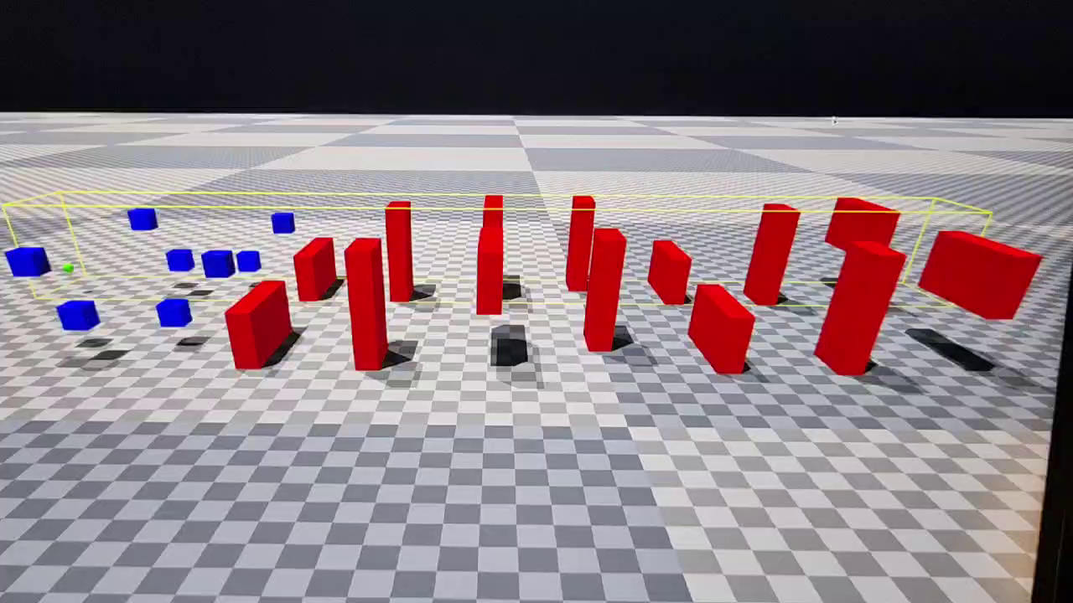
The RL training and the Model result

Slide 12
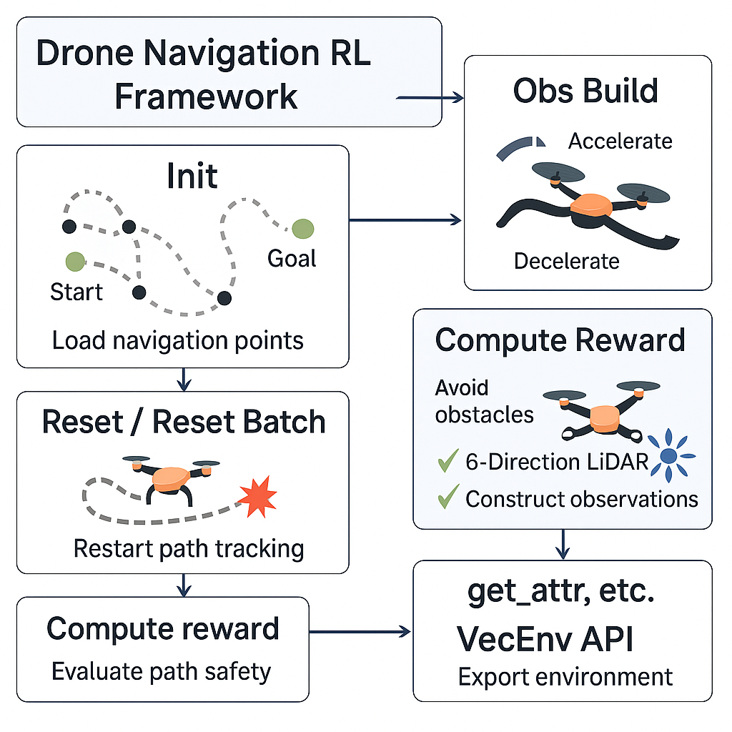
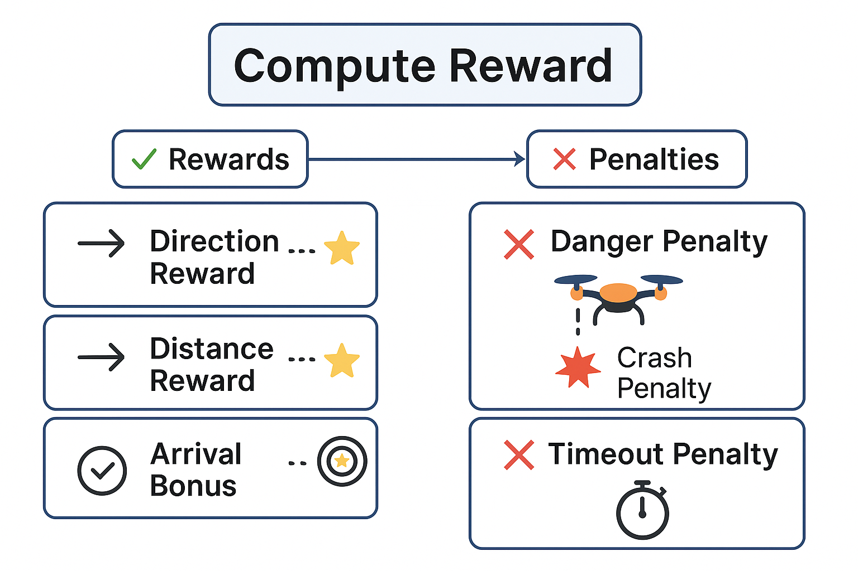
Whole Project Procedure
set Env and Goal

Slide 13
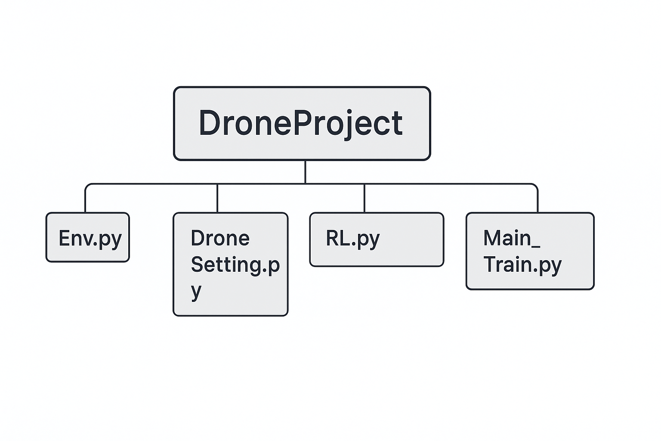
Main structure of the document
Potential Field Method
Work in progress
Visual Detect Module
Complex Neural Network
Successful!
Higher-Level Drone Model
RL-Based Drone Navigation with LiDAR for Obstacle Avoidance

Slide 14
Thank you!

